Slide 1
Spring Boot FreeMarker Tutorial with Example
FreeMarker is a Java-based template engine to generate text outputs such as HTML web pages and emails.
FreeMarker view template files would be created inside src/main/resources/templates. We use the .ftlh file extension instead of ftl to enable the HTML auto-escaping since Spring Boot 2.2
CSS and JavaScript files would be created inside src/main/resources/static

Slide 2
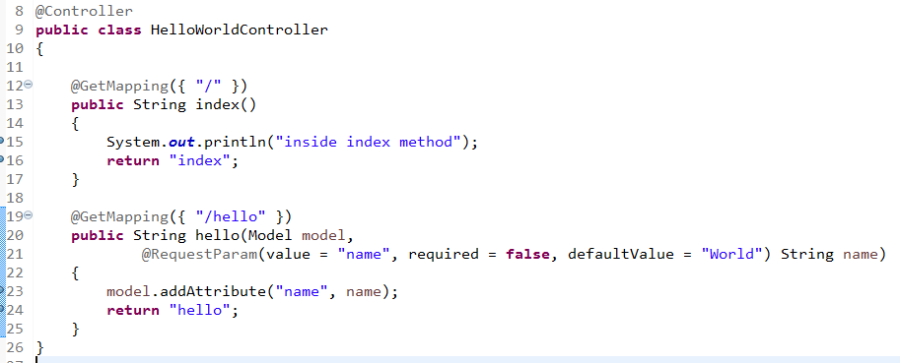
Spring Boot FreeMarker Tutorial with Example
@Controller indicates the annotated class is a web controller
@GetMapping maps HTTP GET request for "/" (home page) and "/hello" web page to the hello method
@RequestParam binds method parameter name to request query string parameter
Model is an object for sharing data between handler and view template
The view template name is defined by the return statement of the handler and the spring.freemarker.suffix config property which defined in the application.properties file. So in this hello handler method, the return view is hello.ftlh

Slide 3
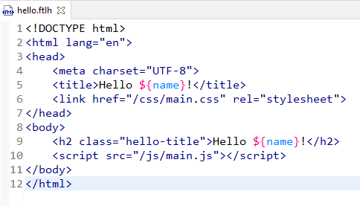
Spring Boot FreeMarker Tutorial with Example
The dynamic message is ${name}. It is a FreeMarker interpolation enabling FreeMarker template files to access the data from the model. Its value is filled by the model.addAttribute("name", name); defined in the HelloWorldController.
Since Spring Boot 2.2, use .ftlh extension instead of .ftl for FreeMarker template files to enable the HTML auto-escaping for FreeMarker interpolations ${...}

